Slide 1
2017-18 Preliminary Budget Development
Presentation to the Board of Trustees
BUDGET STUDY SESSION
March 1, 2017
Presented by Andy Dunn, Ed.D.
Vice Chancellor, Finance and Administrative Services
Inspiration. Innovation. Graduation.

Slide 2
DISCUSSION
SECTION 1 ---- 2015-16
Final Recalculation
Fund Balance Summary
SECTION 2 ---- 2016-17
Changes Since Adoption
FTES @ P-1
SECTION 3 ---- 2017-18 and Beyond
Summary of Governor’s Budget Proposal
FTES Multi-year
Budget Multi-year
Categorical Summary
Pension Contribution Summary
Health Benefit Projection
Preliminary Budget Allocation Model
Preliminary Budget Assumptions
Capital Budget
Budget Development Calendar
SECTION 4 ---- Looking Ahead
Areas of Concern
Things to Watch

Slide 3
SECTION 1 2015-16 FY Summary
Final Recalculation
Fund Balance Summary

Slide 4
WHAT CHANGED WITH THE 2015-16 FINAL RE-CALCULATION?
2015-16
2015-16
Final
P-2
Recalculation
Difference
Funded FTES
32,623
32,623
0
Total Computational Revenue
$
174,737,655
$
174,735,212
$
(2,443)
-
Deficit Factor
100.0%
$
100.0%
$
-
-
$
Available Revenue
$
174,737,655
$
174,735,212
$
(2,443)
NOTES:
No unfunded FTES across the system
No Deficit Factor
27 Districts in Stabilization

Slide 5
UNRESTRICTED GENERAL FUND (UGF) FUND BALANCE TREND WITH COMPARABLE DISTRICTS Ending Balance as of June 30, 2016
NOTES: Data Obtained from the California Community Colleges, Chancellor’s Office, Fiscal Services Unit 311 Reporting: Revenues, Expenditures, and Fund Balance Data for the General Fund for the 2015-2016 Fiscal Year. The percentage values shown reflect the Net Ending Balance as a function of the Expenditures within each District

Slide 6
STATE-WIDE FUND BALANCE SUMMARY Net Ending Balance as a % of UGF Expenditures As of June 30, 2016

Slide 7
SECTION 2 2016-17 FY Status
Changes Since Adoption
FTES @ P-1

Slide 8
WHAT HAS CHANGED SINCE 2016-17 BUDGET ADOPTION?
Revenue | 2016-17 Adopted | 2016-17 Revised
Beginning Balance (District & Colleges) | 47,569,477 | 48,272,956
Total Revenue | 202,264,194 | 207,940,853
Revenue + Beginning Balance | 249,833,671 | 256,213,809
Total Expected Level of Spending | 200,484,852 | 200,742,102
Ending Fund Balance | 49,348,819 | 55,471,707
Ending Fund Balance % | 24.61% | 27.63%
Notes: 1) Change in Beginning Balance reflects PY Audit adjustments

Slide 9
P-1 FTES SUMMARY
 | P-1 Enrollment Reported | 2016-17 Adopted Budget | % - Historic Framework | Over/Under # | Over/Under %
OCC | 15,681.17 | 17,000.26 | 52.11% | -1,319.09 | -7.76%
GWC | 9,049.50 | 9,953.52 | 30.51% | -904.02 | -9.08%
CCC | 5,948.18 | 5,670.02 | 17.38% | 278.16 | 4.91%
Total | 30,678.85 | 32,623.80 | 100.00% | -1,944.95 | -5.96%
Note: 1) Basic allocation FTES thresholds return to 100% of standards, effective 2016-17 fiscal year 2) FTES data revised at P-2

Slide 10
SECTION 3 2017-18 FY and Beyond
Summary of Governor’s Budget Proposal
FTES Multi-year
Budget Multi-year
Categorical Summary
Health Benefit Projection
Preliminary Budget Allocation Model
Pension Contribution Summary
Preliminary Budget Assumptions
Budget Development Calendar

Slide 11
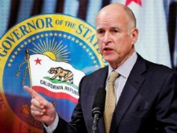
SUMMARY OF GOVERNOR’S BUDGET PROPOSAL
ITEM | SYSTEM AMOUNT (millions) | NOTES
Access/ Growth | $79.3M | Reflects 1.34% to fund growth. Local cap TBD.
COLA | $94.1M | Reflects an estimated 1.48%
Base Augmentation | $23.6M | Prior year amount was $75M
Workforce and CTE Pathways | $248M | No Augmentation
Basic Skills | $30M | No Augmentation
Source: Community College League of California Analysis of Governor’s Budget

Slide 12
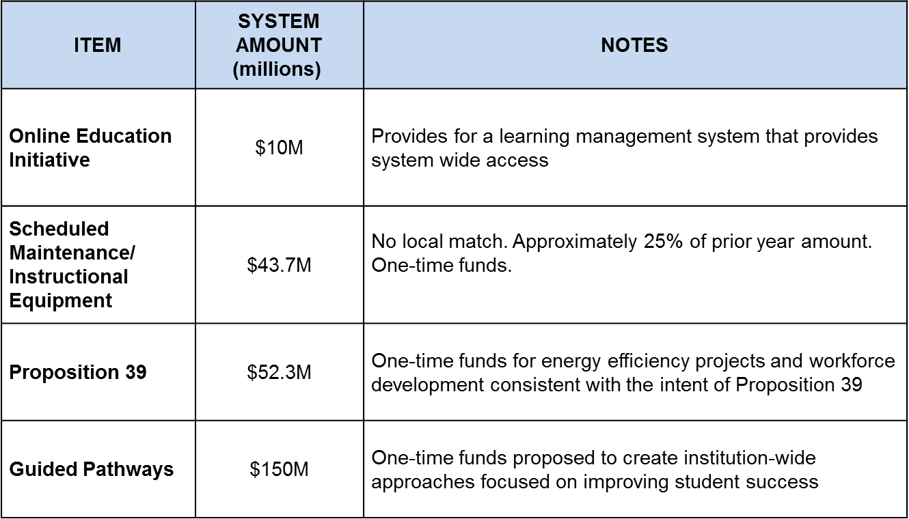
SUMMARY OF BUDGET PROPOSAL (cont.)
Source: Community College League of California Analysis of Governor’s Budget

Slide 13
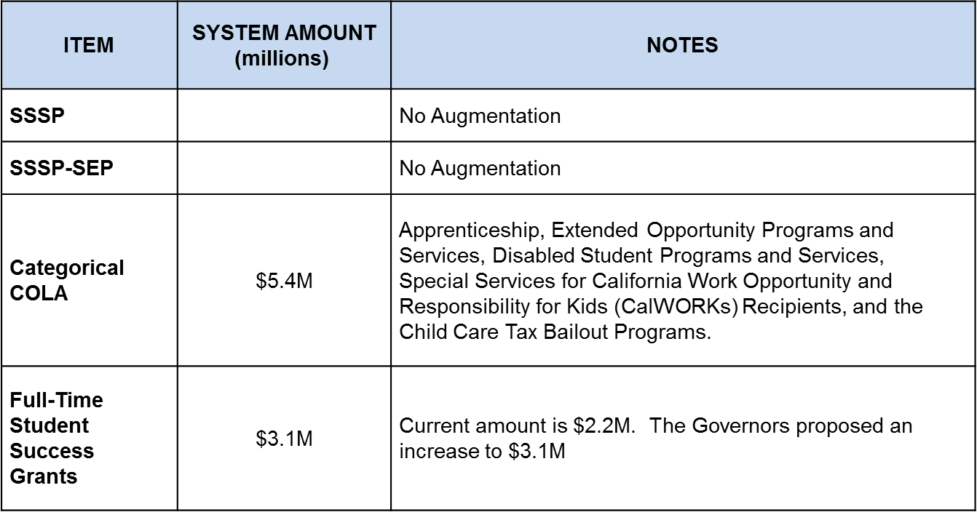
SUMMARY OF BUDGET PROPOSAL (cont.)
Source: Community College League of California Analysis of Governor’s Budget

Slide 14
SUMMARY OF BUDGET PROPOSAL (cont.)
ITEM | SYSTEM AMOUNT (millions) | NOTES
Innovation Award | $20M | Grants related to innovative practices in community colleges
Integrated Library System | $6M | One-time funds allocated for an integrated library system to be developed for all CCC students to have access to a cloud-based library system.
Student Fees | $46/credit unit | No change proposed
Mandate Reimbursement | $0M | One-time funding is provided on a per-FTES basis to retire outstanding mandate claims
Source: Community College League of California Analysis of Governor’s Budget

Slide 15
FTES MULTI-YEAR OUTLOOK

Slide 16
ESTIMATED 2017-18 UGF REVENUE & EXPENSE
2017-18 Budget Development
Estimated new on-going revenue and expense February 2017)
New Revenue |  | State |  | 2017-18 Estimated |  | 2018-19 Projection
COLA |  | $94.1 million | 1.48% | $ 2,586,117 |  | $ 4,273,803
Growth |  | $79.3 million | 1.34% | $ - |  | $ -
Base Augmentation |  | $27.1 million | 0.43% | $ 751,372 |  | $ -
Other |  |  |  | $ - |  | $ -
Subtotal |  |  |  | $ 3,337,489 |  | $ 4,273,803
New Expense
COLA pass-through |  |  |  | $ 2,198,200 |  | $ 3,632,733
Health Benefits |  |  |  | $ 742,000 |  | $ 742,000
PERS |  |  |  | $ 1,126,285 |  | $ 1,749,618
STRS |  |  |  | $ 1,330,663 |  | $ 1,362,865
Net Step/Column |  |  |  | $ 300,000 |  | $ 300,000
Subtotal |  |  |  | $ 5,697,148 |  | $ 7,787,216
Balance/Deficit |  |  |  | $ (2,359,658) |  | $ (3,513,412)
Percent Increase of Deficit from 2017-18 to 2018-19 |  |  |  |  |  | 48.89%
Notes:
Total computational revenue @ 2015-16 P-2
Assumes no earned growth. Local cap TBD
Pension cost from SSC CCC Financial Projection Dartboard
2018-19 COLA est 2.4%

Slide 17
MULTI-YEAR UGF PROJECTION
REVENUE | 2015-16 Audited Actual | 2016-17 Projection | 2017-18 Projection | 2018-19 Projection | 2019-20 Projection | 2020-21 Projection
Beginning Balance (District & College) | $35,522,615 | $48,272,956 | $55,471,707 | $55,943,769 | $52,910,411 | $46,378,878
Total Revenue | $225,415,360 | $207,940,853 | $208,437,183 | $212,764,259 | $217,693,664 | $224,631,242
Total Rev & Beg Balance | $260,937,975 | $256,213,809 | $263,908,890 | $268,708,028 | $270,604,075 | $271,010,120
Total Expenditures | $212,665,019 | $200,742,102 | $207,965,121 | $215,797,618 | $224,225,197 | $232,751,557
Revenue - Expenses | $12,750,341 | $7,198,751 | $472,062 | ($3,033,359) | ($6,531,533) | ($8,120,315)
Ending Fund Balance | $48,272,956 | $55,471,707 | $55,943,769 | $52,910,410 | $46,378,878 | $38,258,563
Ending Fund Balance % | 22.70% | 27.63% | 26.90% | 24.52% | 20.68% | 16.44%
2016-17 and Beyond:
1. COLA: Zero for 2016-17. Per SSC in out years (1.48, 2.40, 2.53, 2.66)
2. Growth: Zero through 2019-20. 1% in 2020-21
3 Net effect of Step/Column @ $300,000/year
4 PERS employer match for 2016-17: 13.89. Out years: (15.8, 18.7, 21.6, 24.9)
6. Sunset of SUT under Prop 30 reflected in state projections
5 STRS employer match for 2016-17: 12.58. Out years: (14.43, 16.28, 18.13, 19.10)
6. No assumption made about ACA "Cadillac Tax"
7. Health Benefits reflects ~$742k increase/annually
8. No misc new cost (software license, legal, insurance, regulatory)
9. No assumption made about sunset of PIT under Prop 30

Slide 18
MULTI-YEAR UGF PROJECTION A COMPARISON OF REVENUE AND EXPENSES
Balance/Deficit
$12,750,341 | $7,198,751 | $472,062 | ($3,033,359) | ($6,531,533) | ($8,120,315)

Slide 19
PRELIMINARY CATEGORICAL PROGRAM FUNDING Proposed 2017-18 Budget
Programs | 2015-16 Actuals | 2016-17 Adjusted Budget | 2016-17 Actuals as of February 14, 2017 |  | 2017-18 Projected Budget
Student Success and Support Program* | 6,630,242 | 9,455,360 | 4,091,168 |  | 6,741,359
Student Equity* | 2,500,429 | 5,515,281 | 2,335,164 |  | 3,184,269
DSPS Program | 3,106,807 | 3,204,715 | 1,700,421 |  | 3,044,479
EOPS Program | 3,169,357 | 3,237,764 | 1,656,231 |  | 3,075,876
Basic Skills Program | 433,014 | 860,939 | 225,304 |  | 431,367
Adult Education (Local) | 427,395 | 3,372,633 | 310,178 |  | 1,763,203
Strong Workforce | - | 2,414,498 | - |  | 2,293,773
One-Time Funds
Maintenance, Instructional Equipment | 1,601,276 | 5,255,686 | 3,020,243 |  | 1,311,000
Mandate Backlogs | 13,000,000 | 3,165,000 | - |  | -
Other
Proposition 39 | 442,623 | 1,192,413 | 239,584 |  | 1,489,504
Notes: 1) As of February 14, 2017, District will have 2 years to expend BSI, SE and SSSP funds (June 30, 2018) 2) Adjusted Budget and Actuals includes prior carryover for programs with categorical provisions 3) DSPS, EOPS, special services for CalWORKS receive COLA

Slide 20
Benefit Renewal Data for Benefit Year Beginning October 1, 2017
– PENDING –

Slide 21
EMPLOYER PENSION MATCH
Changes under the Public Employee Pension Reform Act of 2012 (PEPRA)
 |  | STRS |  |  | PERS |  |  | Cumulative Total
Effective Date |  | Employer Match | Amount |  | Employer Match | Amount
July 1, 2015 |  | 10.73% | $1,273,007 |  | 11.847% | $44,277 |  | $1,317,285
July 1, 2016 |  | 12.58% | $1,305,724 |  | 13.89% | $1,189,075 |  | $2,494,799
July 1, 2017 |  | 14.43% | $1,330,663 |  | 15.80% | $1,126,285 |  | $2,456,948
July 1, 2018 |  | 16.28% | $1,362,865 |  | 18.70% | $1,749,618 |  | $3,112,483
July 1, 2019 |  | 18.13% | $1,399,254 |  | 21.60% | $1,796,332 |  | $3,195,586
July 1, 2020 |  | 19.10% | $748,336 |  | 24.90% | $2,084,985 |  | $2,833,320
Subtotal |  |  | $7,419,848 |  |  | $7,990,572 |  | $15,410,420
Notes: CalPERS reduced it’s Long Term discount rate from 7.5% to 7.0% This change accelerates an upward climb to the projected rate of 28.2% in 2023-24. The employer contribution rates were increased for CalSTRS as well, however legislative action is required to confirm this change.

Slide 22
CalPERS EMPLOYER PENSION MATCH
Notes: The projected employer contribution rate of 28.2% for 2023-24 is 2.4 times that of the employer contribution rate of 11.847% in 2015-16, an increase of 138% in eight years.

Slide 23
CalSTRS EMPLOYER PENSION MATCH

Slide 24
2017-18 FY PRELIMINARY BUDGET ASSUMPTIONS
District will maintain compliance with 50% law
District will target faculty hires consistent with faculty hiring plan
Vacancies due to retirement or resignation will not automatically be filled
The District will develop a balanced budget with a minimum 8% reserve consistent with BP 6300
COLA is estimated at 1.48%
State-wide growth is estimated at 1.34%. Local Cap TBD.
Growth will be budgeted at 0
Pension contribution increases will be budgeted as shown above
The budget will be predicated on 32,623 resident FTES
Non Resident Tuition set at $271/unit

Slide 25
PRELIMINARY CAPITAL BUDGET
Measure M
Board Approved 2017 D/E Issuance February 2017
Series F, final issuance, projected for 2020
Major project work expected to wrap up ~ 2022
Standard & Poor’s Global Ratings raised its long-term rating and underlying rating to AA+
Measure M Endowment
On-going revenue stream for technology and deferred maintenance from 2018 to 2036
Capital Program limitations
Actual Measure M resources reflect only 70% of Vision 2020 needs
Program delay associated with CEQA
Limited ability to leverage State funds
Proposition 51
Governor may begin to issue bonds fall 2017
System office signaled willingness to roll-over 2017-18 capital spend plan
Looking Ahead
Begin Vision 2030 Master Plan ~2017-18
Unfunded projects from Vision 2020 will inform planning

Slide 26
BUDGET DEVELOPMENT CALENDAR
JANUARY | Initiate 2017/18 budget process Governor’s 2017/18 Budget Proposal released
FEBRUARY | 2016/17 Final Recalculation released 2017/18 P-1 Apportionment Report released
APRIL | Continue/Refine process
MAY | Colleges and District Administrative Services continue 2017/18 input Budget input for Tentative Budget due from colleges May Revise
JUNE | 2017/18 P-2 Apportionment Report released 2017/18 Tentative Budget adopted by Board of Trustees
JULY | Budget input for Adopted Budget due from colleges
AUGUST | 2017/18 Adopted Budget reviewed by Chancellor’s Cabinet
SEPTEMBER | Adopted Budget available for public inspection and review prior to public hearing and adoption in the District Office Lobby 2017/18 Adopted Budget presented for public hearing and adoption by Board of Trustees 2017/18 Adopted Budget filed with the County Department of Education

Slide 27
SECTION 4 Looking Ahead

Slide 28
AREAS OF CONCERN
Prop 98 split of 10.93%
Proposes a split of 10.87% for CCC, a difference of ~$43M.
PERS and STRS
Continued upward pressure on employer pension match
Base Augmentation
Proposes [only] $23.6 million
Statewide Education Bond (Prop 51)
Only five of 29 capital projects included in budget proposal
Cal-Grant Middle Class Scholarship
Proposed phase-out.
March 1, 2017, BOT

Slide 29
LOOKING AHEAD – things to watch
Preliminary Budget will continue to take shape
P-1 Apportion Report released February/March 2017
2015-16 Final Re-Calculation released February/March 2017
Refinement of Budget Assumptions
Budget Development Calendar snapshot
DCC Budget Subcommittee – March 3, 2017

